Slide 1
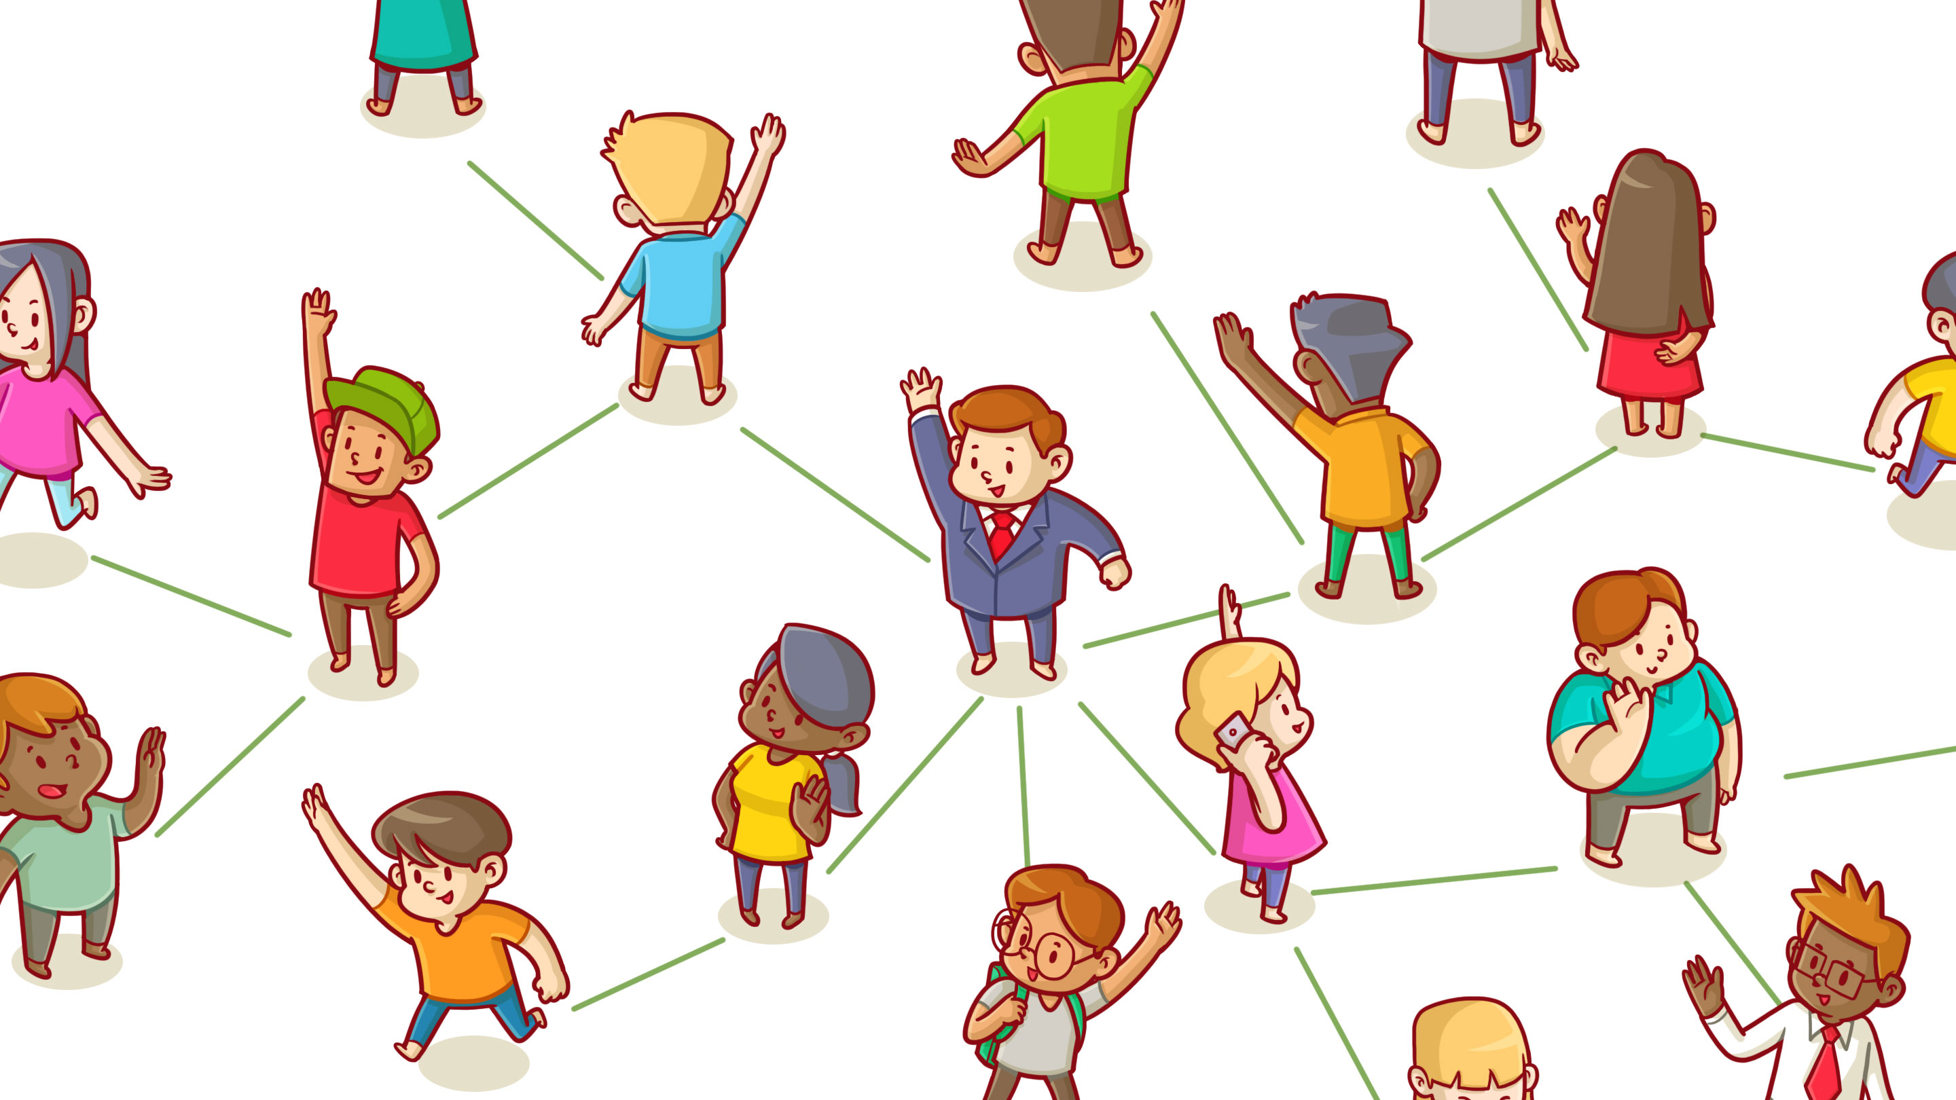
Network Analysis Project
Dari-Khanda Garmaeva

Slide 2

Outline: a graph of Dari’s VK friends
1) Network summary
2) Structural analysis:
Centrality
Assortativity
Similarity
Approximating random graph
3) Community detection:
Cliques
K-shells
Communities
This is Dari

Slide 3


Network summary
1) Data collection – VK API (‘vk library’)
2) Attributes of nodes*:
Name
Sex
City
Education
3) Key information:
Number of nodes – 244
Number of edges – 1457
Diameter – 12
Average clustering coefficient** – 0.545
Number of connected components – 10
Density – 0.049
*NA for missing values (deleted)
**for largest connected component

Slide 4
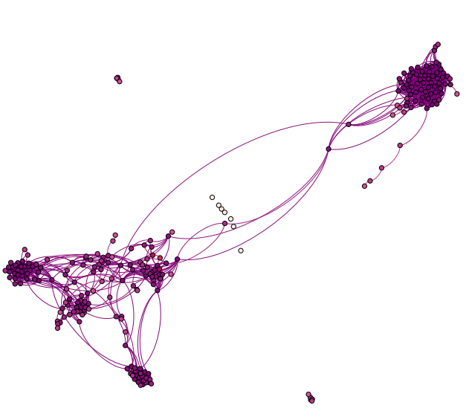
Network summary. Layout
The biggest connected component – Bachelor’s degree friends (1)
There is a chain of friends (2), which is connected to (1), that I went to GMAT preparatory courses with. Intuitively, they all should be friends with each other. But each of them only has 1 friend. The story behind it: an university friend knows a shy girl from GMAT courses, the shy girl is a friend only to the most sociable guy, who used to date one of two female friends, who came to GMAT courses together. The breakup was so tough, that the sociable guy and the female friend #1 unfollowed each other, but the sociable guy and the female friend #2 are still friends. So the chain unfolds this way: university friend – shy girl – sociable guy – female friend #2 – female friend #1.
2 separate disconnected groups are Master’s degree (5) and USA summer trip friends(4)
Different people I met during trips abroad (3)
High school friends (6)
Buryad diaspora in New-York(7), where I lived for over a year
Relatives(8)
Elementary school friends(9)
1
4
2
7
6
3
8
5
9

Slide 5
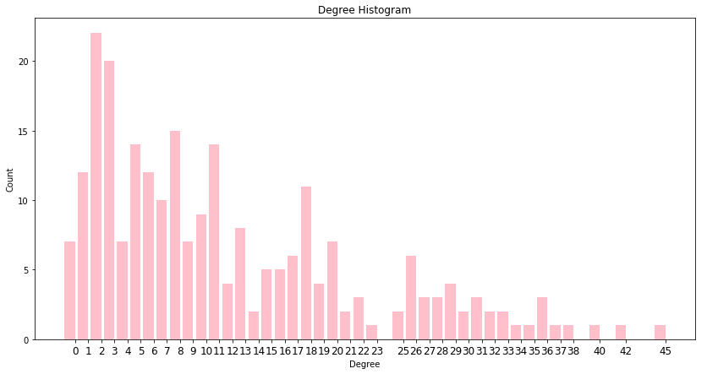
Network summary. Node degrees
Power-law nature
The majority of node have <10 connections
Min degree – 0
Max degree - 45

Slide 6
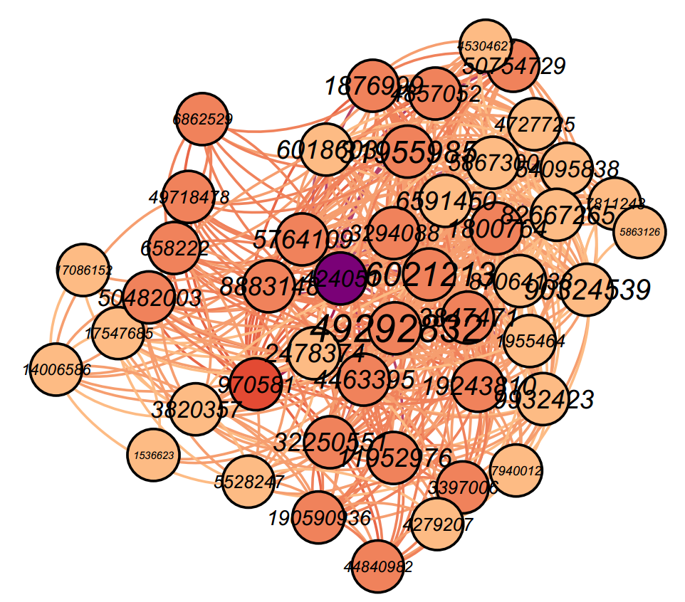


Structural analysis. Degree centrality
Top node 49292832, a very close friend of mine, has value of degree centrality of (0.185), knows most of my Bachelor’s degree friends, which is a biggest connected component

Slide 7

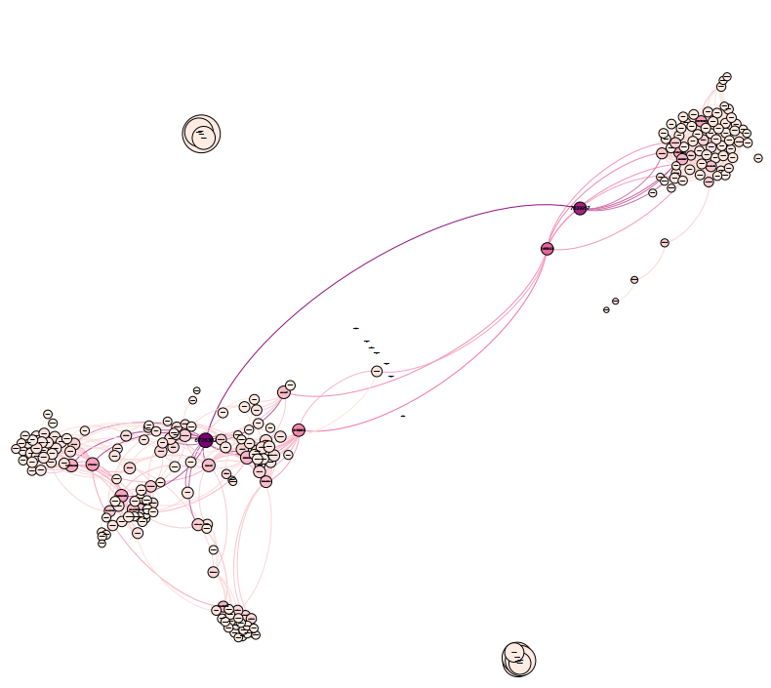



Structural analysis. Closeness centrality
Top 1 node 6726382 with closeness centrality (0.343) is a son of the 1989 Wrestling World Champion, knows a lot of people from my hometown.
Top 2 node 2746864 with closeness centrality (0.308) is a boy from my hometown, who also worked in New York at the same time as I did.

Slide 8
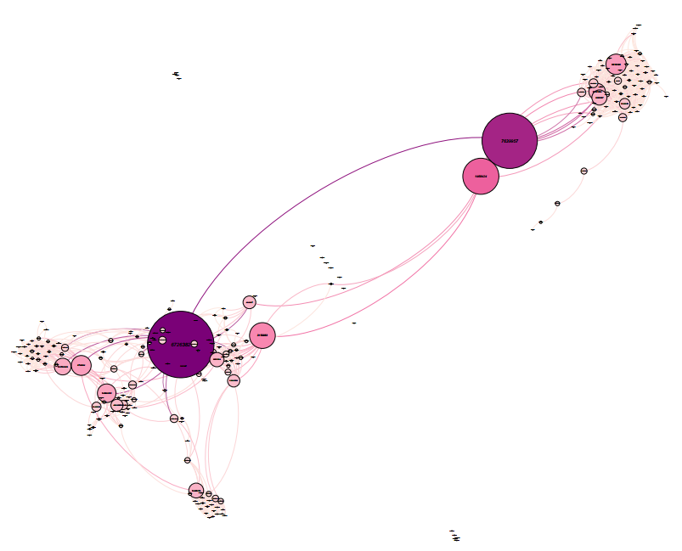



Structural analysis. Betweenness centrality
Top 1 node 6726382 with betweenness centrality (0.276) is the same.
Top 2 node 7639957 with betweenness centrality (0.229) is a girl from my hometown, who also studied with me at the same Bachelor program.

Slide 9


Structural analysis. Pagerank
Top 1 node 20122298 with page rank of (0.009) is my close high school friend. This is a node in a smaller cluster, but has a significant value

